Slide 1
CSE 574 Lecture 17: Hidden Markov Models
Professor: Stephanie Gil
Email: sgil@asu.edu (Office hours M 12-1pm BYENG 386)
TAs: Sushmita Bhattacharya sbhatt55@asu.edu (Office hours M 5-6 BYENG 392)
Weiying Wang wwang239@asu.edu (Office hours Th 2:30-3:30 BYENG 392)

Slide 2
Last Time
Feature-based learning
Introduction to partially observable states

Slide 3
Today
Hidden Markov Models
Inference with hidden state
Filtering
Prediction
Smoothing
Viterbi Algorithm
Partially Observable Markov Decision Processes (next time)

Slide 4
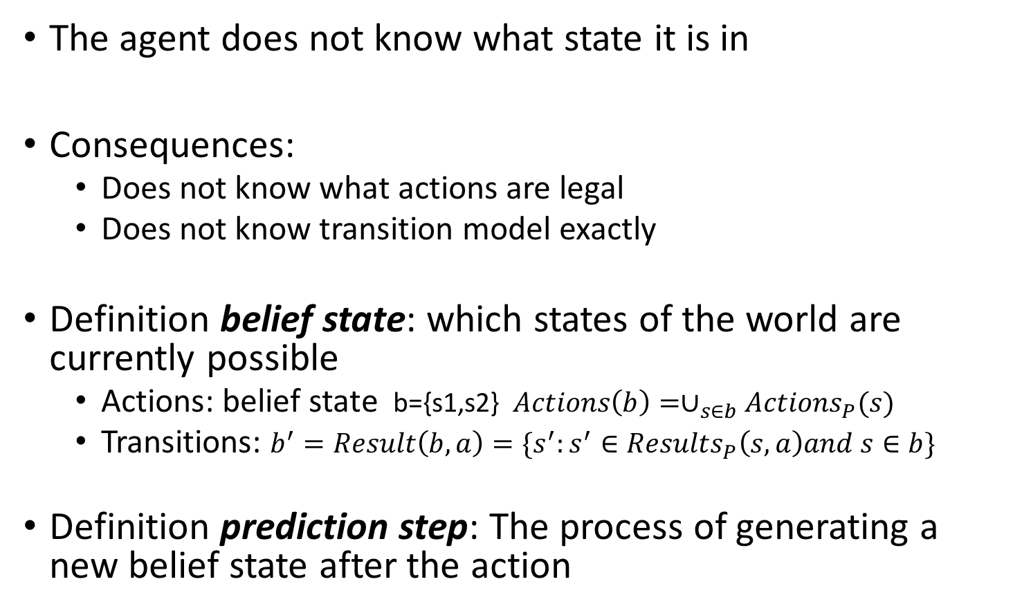
Belief State
The agent does not know what state it is in
Consequences:
Does not know what actions are legal
Does not know transition model exactly
Definition belief state: which states of the world are currently possible
Actions: belief state b={s1,s2} $Actions\left(b\right)=∪_{s∈b}Actions_{P}(s)$
Transitions: $b^{′}=Result\left(b,a\right)=\{s^{′}:s^{′}∈Results_{P}\left(s,a\right)and s∈b\}$
Definition prediction step: The process of generating a new belief state after the action

Slide 5
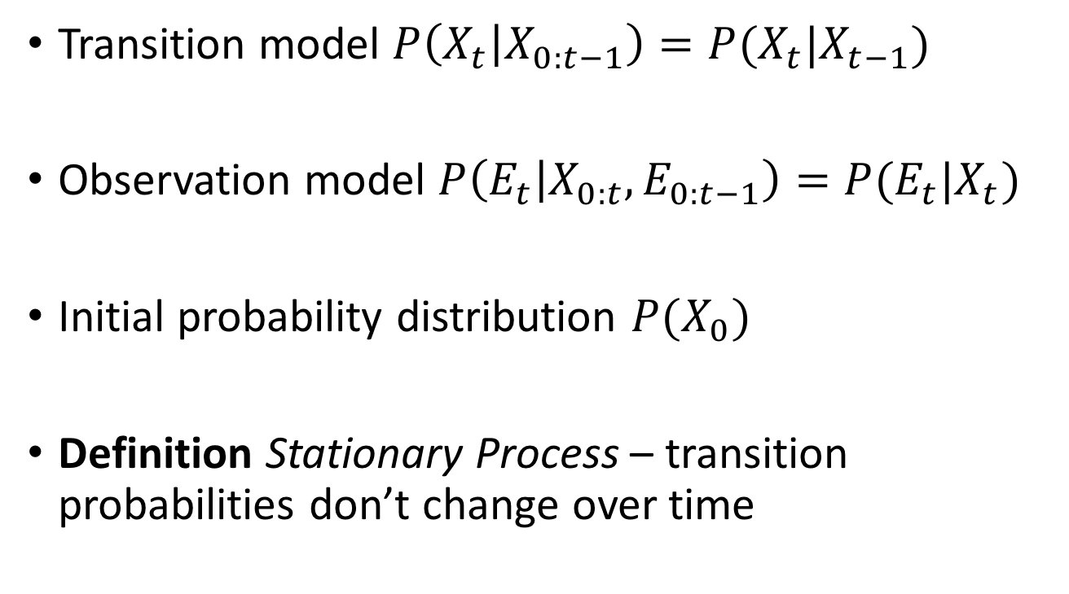
Transition and Sensor Models
Markov assumption
Transition model $P\left(X_{t} | X_{0:t−1}\right)=P(X_{t}|X_{t−1})$
Observation model $P\left(E_{t} | X_{0:t},E_{0:t−1}\right)=P(E_{t}|X_{t})$
Initial probability distribution $P(X_{0})$
Definition Stationary Process – transition probabilities don’t change over time

Slide 6
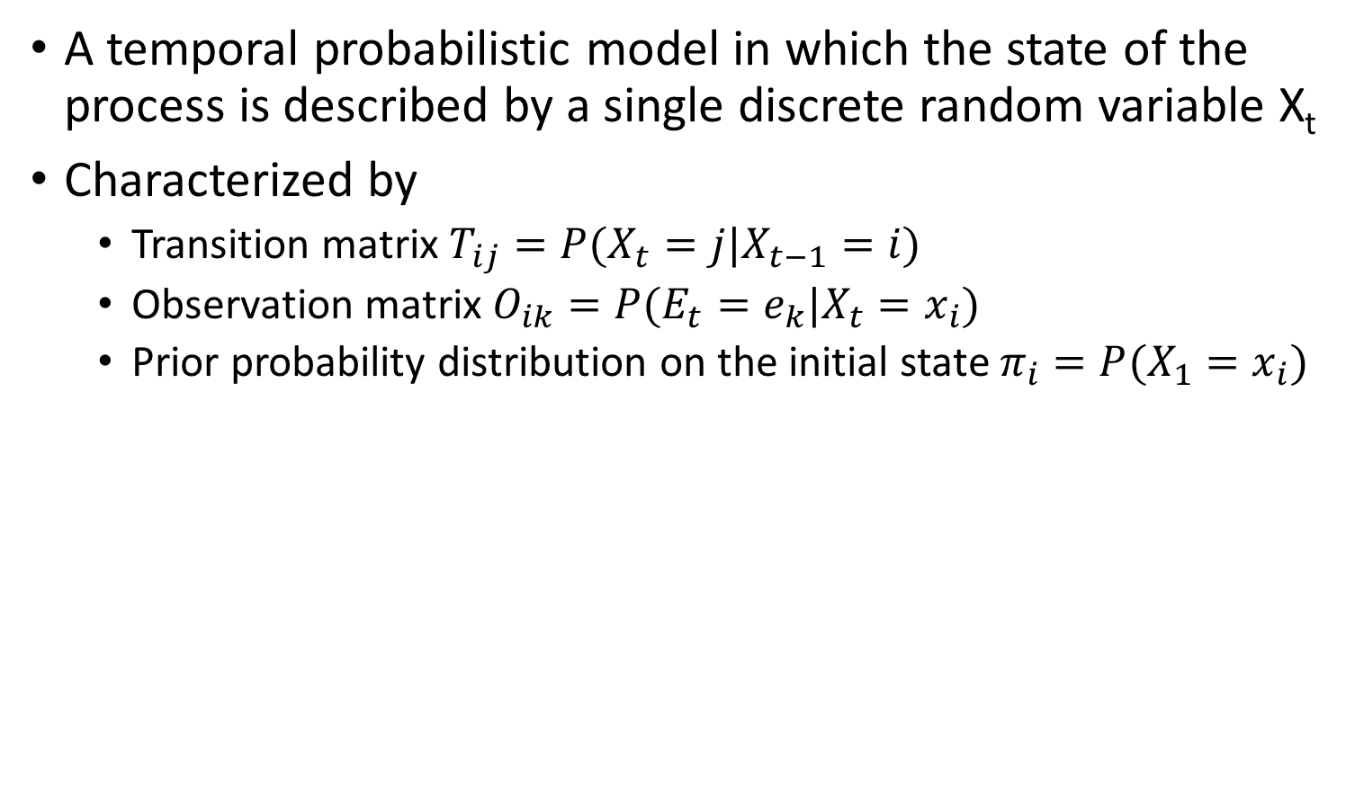
Hidden Markov Model (HMM)
A temporal probabilistic model in which the state of the process is described by a single discrete random variable X_{t}
Characterized by
Transition matrix $T_{ij}=P(X_{t}=j|X_{t−1}=i)$
Observation matrix $O_{ik}=P(E_{t}=e_{k}|X_{t}=x_{i})$
Prior probability distribution on the initial state $π_{i}=P(X_{1}=x_{i})$

Slide 7
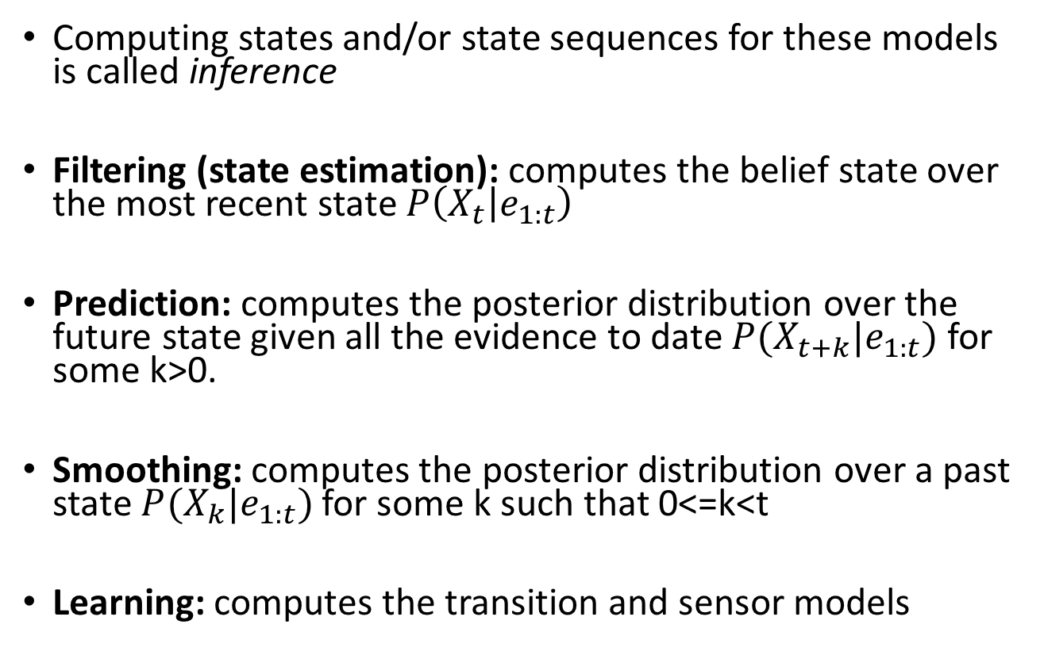
Computations of Interest
Computing states and/or state sequences for these models is called inference
Filtering (state estimation): computes the belief state over the most recent state $P\left(X_{t} | e_{1:t}\right)$
Prediction: computes the posterior distribution over the future state given all the evidence to date $P(X_{t+k}|e_{1:t})$ for some k>0.
Smoothing: computes the posterior distribution over a past state $P(X_{k}|e_{1:t})$ for some k such that 0<=k<t
Learning: computes the transition and sensor models

Slide 8
Filtering (State Estimation)
Estimate the current state given a history of observations and the current observation
?
Figure 15.3 in Russell and Norvig text

Slide 9
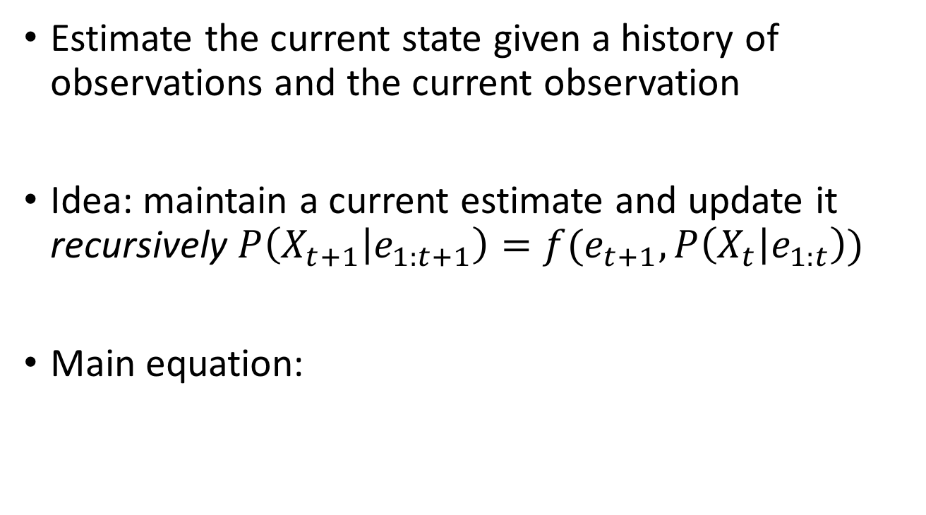
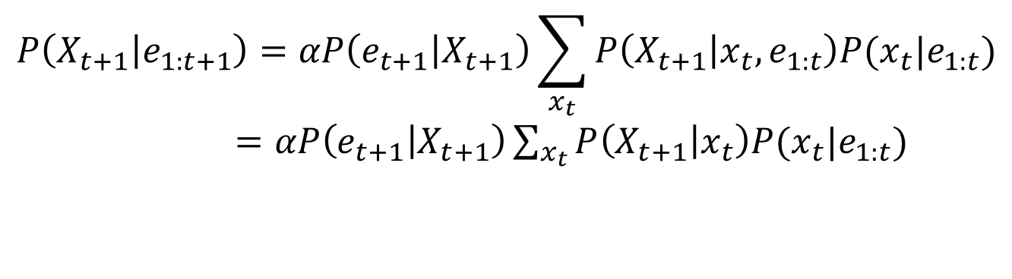
Filtering (State Estimation)
Estimate the current state given a history of observations and the current observation
Idea: maintain a current estimate and update it recursively $P\left(X_{t+1} | e_{1:t+1}\right)=f(e_{t+1},P\left(X_{t} | e_{1:t}\right))$
Main equation:
$$P\left(X_{t+1} | e_{1:t+1}\right)=αP\left(e_{t+1} | X_{t+1}\right)\sum_{x_{t}}{P\left(X_{t+1} | x_{t},e_{1:t}\right)P(x_{t}|e_{1:t})}$$
$=αP\left(e_{t+1} | X_{t+1}\right)\sum_{x_{t}}{P\left(X_{t+1} | x_{t}\right)P(x_{t}|e_{1:t})}$
Markov assumption

Slide 10
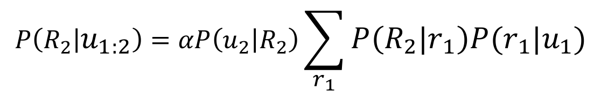

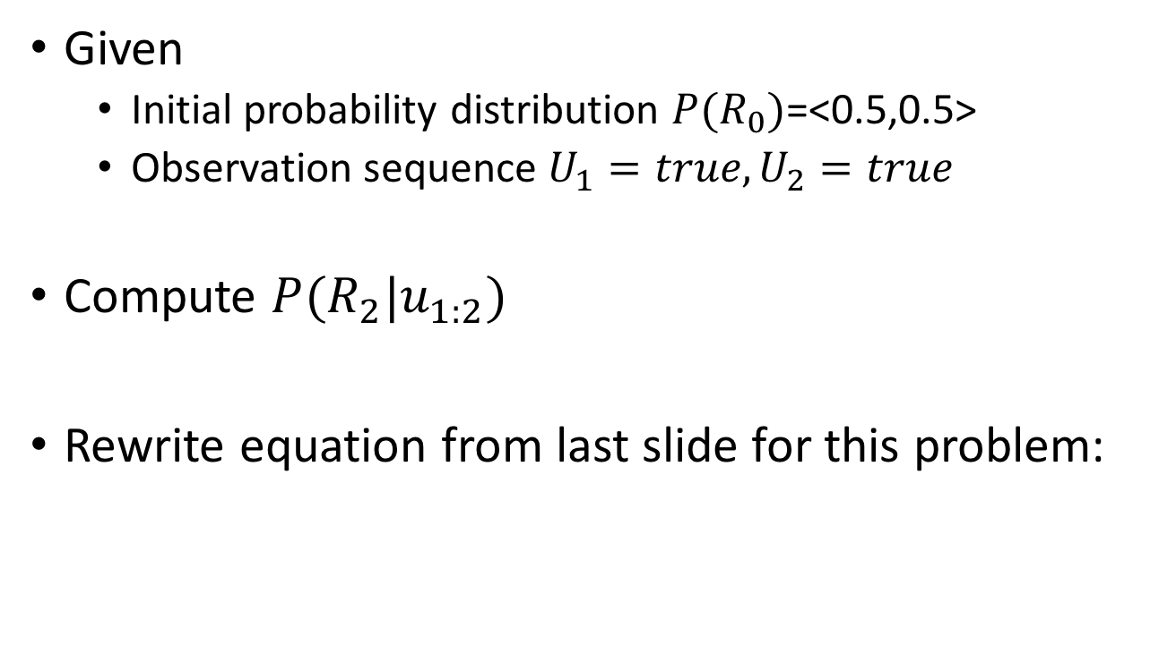
Filtering Example: Rainy Days Problem
Given
Initial probability distribution $P(R_{0})$=<0.5,0.5>
Observation sequence $U_{1}=true, U_{2}=true$
Compute $P(R_{2}|u_{1:2})$
Rewrite equation from last slide for this problem:
$$P\left(R_{2} | u_{1:2}\right)=αP\left(u_{2} | R_{2}\right)\sum_{r_{1}}{P\left(R_{2} | r_{1}\right)P(r_{1}|u_{1})}$$
$$P(R_{2}|u_{1})$$

Slide 11
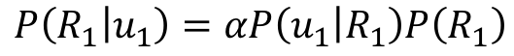
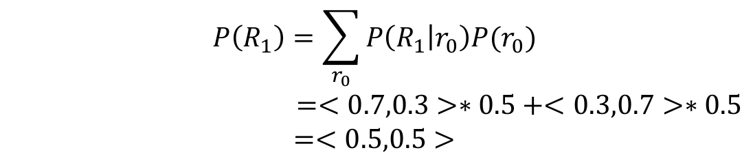
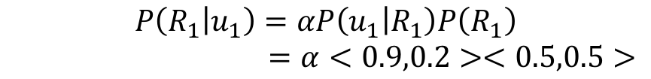
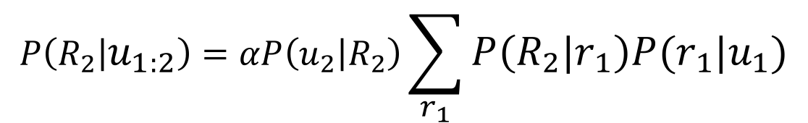
Filtering Example: Rainy Days Problem
What we want to compute:
What we need to compute using given information and initial distribution over the states:
$$P\left(R_{2} | u_{1:2}\right)=αP\left(u_{2} | R_{2}\right)\sum_{r_{1}}{P\left(R_{2} | r_{1}\right)P(r_{1}|u_{1})}$$
Probability of Rain or noRain given observation u₁ (posterior)
$$P\left(R_{1} | u_{1}\right)=αP\left(u_{1} | R_{1}\right)P\left(R_{1}\right)$$
Probability of Rain or noRain given transition probability (prior)
$$P\left(R_{1}\right)=\sum_{r_{0}}{P\left(R_{1} | r_{0}\right)P(r_{0})}$$
$=<0.7,0.3>∗0.5+<0.3,0.7>∗0.5$
$$=<0.5,0.5>$$
$$P\left(R_{1} | u_{1}\right)=αP\left(u_{1} | R_{1}\right)P\left(R_{1}\right)$$
$=α<0.9,0.2><0.5,0.5>$

Slide 12
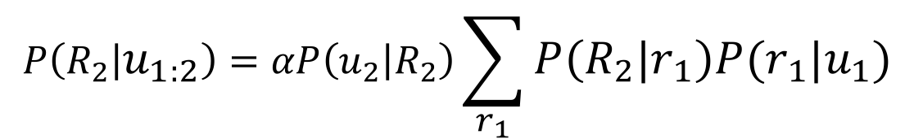
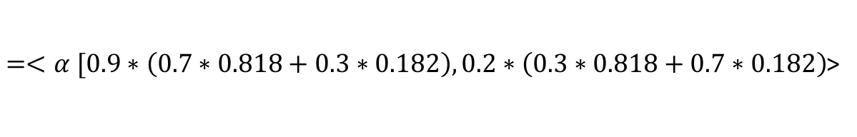
Filtering Example: Rainy Days Problem
Now we have enough information to compute the desired quantity
Transition probability
$$P\left(R_{2} | u_{1:2}\right)=αP\left(u_{2} | R_{2}\right)\sum_{r_{1}}{P\left(R_{2} | r_{1}\right)P(r_{1}|u_{1})}$$
Incorporate evidence
Computed on last slide
$=<α [0.9∗\left(0.7∗0.818+0.3∗0.182\right),0.2∗\left(0.3∗0.818+0.7∗0.182\right)$>
Rain
No Rain

Slide 13
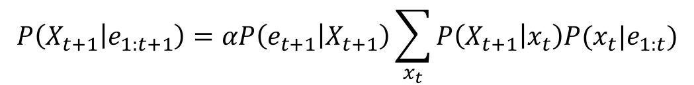
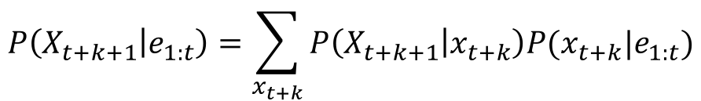
Prediction
Filtering without having evidence at the current timestep
?
?
$$P\left(X_{t+1} | e_{1:t+1}\right)=αP\left(e_{t+1} | X_{t+1}\right)\sum_{x_{t}}{P\left(X_{t+1} | x_{t}\right)P(x_{t}|e_{1:t})}$$
Filtering
$$P\left(X_{t+k+1} | e_{1:t}\right)=\sum_{x_{t+k}}{P\left(X_{t+k+1} | x_{t+k}\right)P(x_{t+k}|e_{1:t})}$$
Prediction

Slide 14
Smoothing
Compute the distribution over past states given evidence up to the present
Most accurate estimation (uses the most evidence)
Forward-Backward Algorithm
?
$$P\left(X_{k} | e_{1:t}\right)=αP\left(X_{k} | e_{1:k}\right)P(e_{k+1:t}|X_{k})$$
forward
backward

Slide 15
Most Likely Sequence
Suppose that I observe
Umbrella=[true, true, false, true, true]
What is the most likely weather sequence for those days?
Figure: 15.5 in Russell and Norvig text

Slide 16
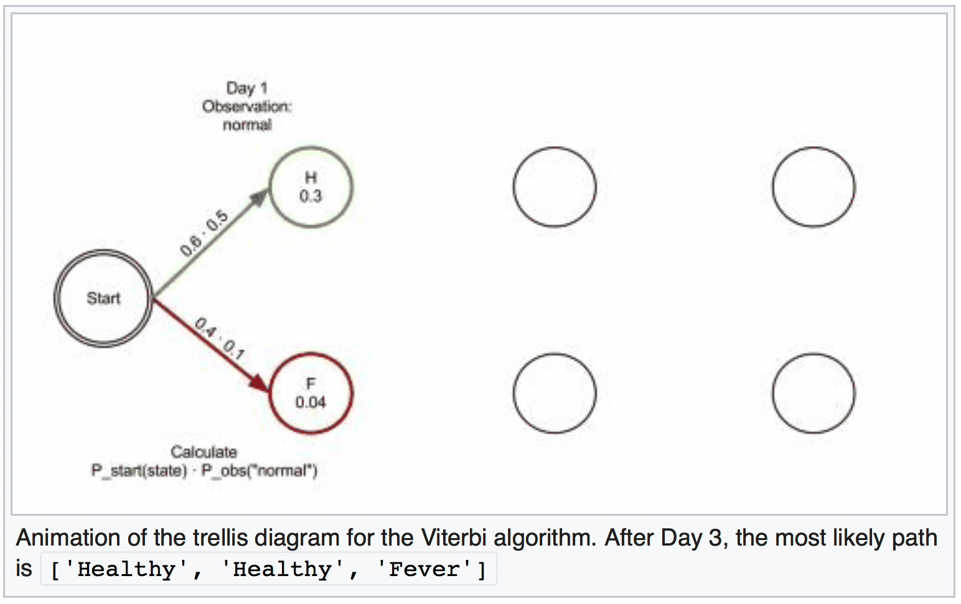
The Viterbi Algorithm
Sometimes we want to know an entire sequence of values for the hidden state
Source: Wikipedia “Viterbi Algorithm”

Slide 17
What is the Importance of this?
Preventing errors in digital communication over wireless medium
Speech recognition
Speech to text
Genomic sequencing

Slide 18
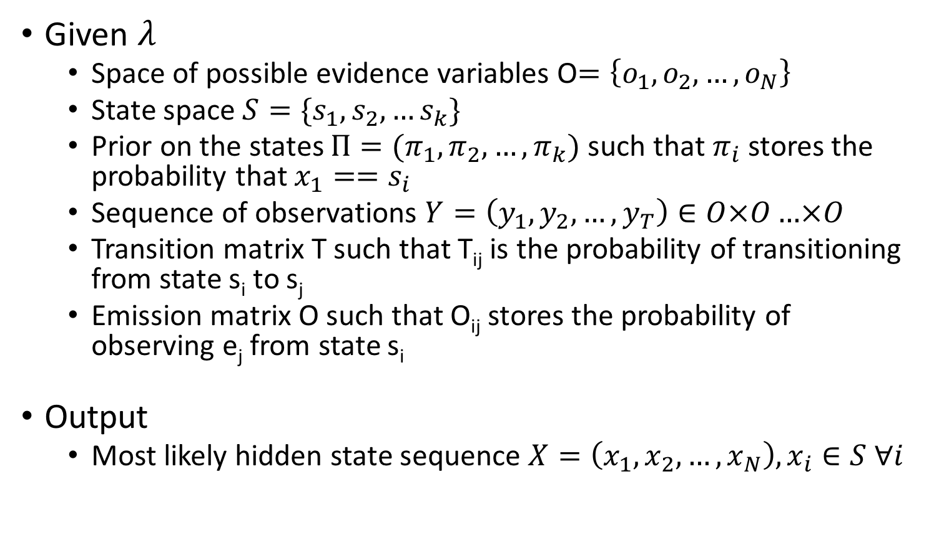
The Viterbi Algorithm
Given $λ$
Space of possible evidence variables O$=\left\{o_{1},o_{2},…,o_{N}\right\}$
State space $S=\{s_{1},s_{2},…s_{k}\}$
Prior on the states $Π=(π_{1},π_{2},…,π_{k})$ such that$π_{i}$stores the probability that $x_{1}==s_{i}$
Sequence of observations $Y=\left(y_{1},y_{2},…,y_{T}\right)∈O×O…×O$
Transition matrix T such that T_{ij} is the probability of transitioning from state s_{i} to s_{j}
Emission matrix O such that O_{ij} stores the probability of observing e_{j} from state s_{i}
Output
Most likely hidden state sequence $X=\left(x_{1},x_{2},…,x_{N}\right), x_{i}∈S ∀i$

Slide 19
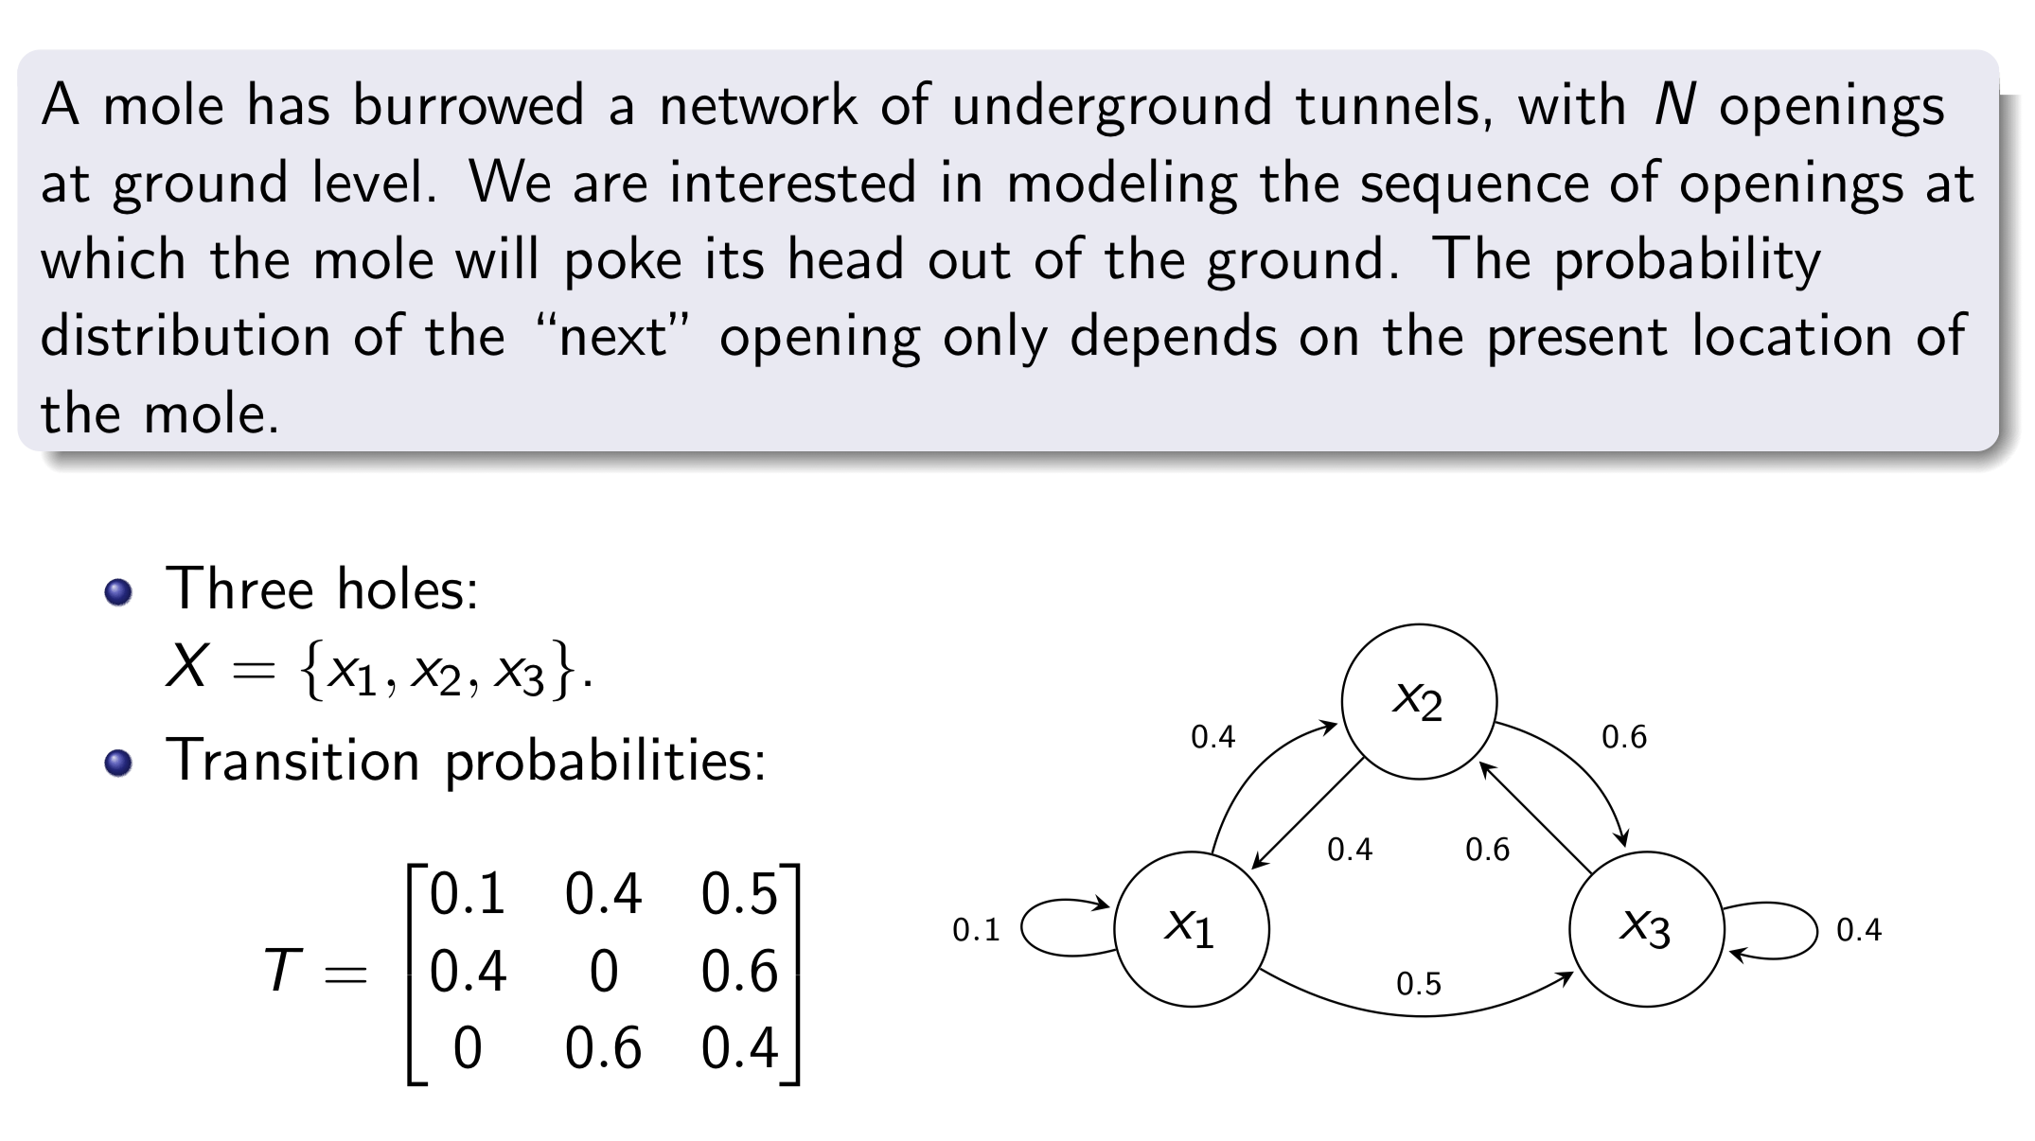
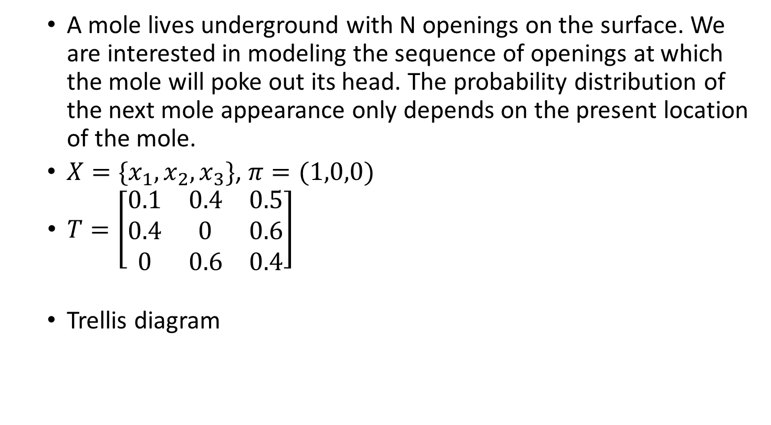
Example: “Whack” a Mole
A mole lives underground with N openings on the surface. We are interested in modeling the sequence of openings at which the mole will poke out its head. The probability distribution of the next mole appearance only depends on the present location of the mole.
$X=\{x_{1},x_{2},x_{3}\}$, $π=(1,0,0)$
$T=\left[\begin{matrix}0.1 & 0.4 & 0.5 \\ 0.4 & 0 & 0.6 \\ 0 & 0.6 & 0.4\end{matrix}\right]$
Trellis diagram
x₁
x₁
x₁
x₁
x₂
x₂
x₂
x₂
x₃
x₃
x₃
x₃
t=0
t=1
t=2
t=3

Slide 20
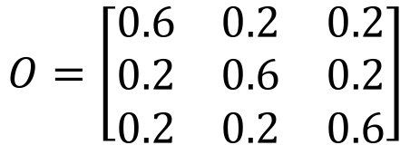
Example: Model a Mole
Assume that it is dark but you can hear the mole (with some uncertainty) every time that it surfaces with the following probabilities
Over three times that the mole surfaces we make the following measurements Y=(1,3,3)
Problem: compute the most likely state trajectory (Viterbi algorithm)
$$O=\left[\begin{matrix}0.6 & 0.2 & 0.2 \\ 0.2 & 0.6 & 0.2 \\ 0.2 & 0.2 & 0.6\end{matrix}\right]$$

Slide 21
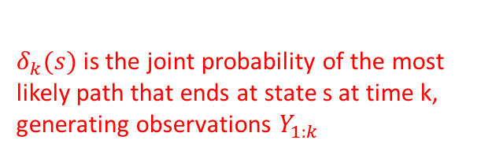
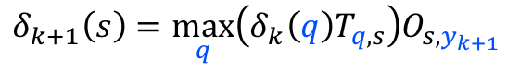

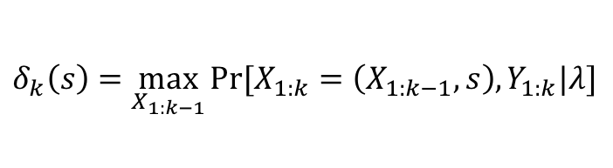
Example: Model a Mole
Key: Viterbi algorithm uses dynamic programming and the Markov property of the HMM
Define
Then:
Iterate to find the probability of the most likely path that ends at each possible state x at the final time. The highest probability path is the desired solution
(1,3,3)
$δ_{k}(s)$is the joint probability of the most likely path that ends at state s at time k, generating observations $Y_{1:k}$
$$δ_{k}\left(s\right)=\max_{X_{1:k−1}}{Pr⁡[X_{1:k}=\left(X_{1:k−1},s\right),Y_{1:k}|λ]}$$
x₁
x₁
x₁
x₁
x₂
$$y_{k+1}=3$$
x₂
x₂
q
x₃
x₃
s
x₃
t=0
t=1
t=2
t=3
k
transition probability
observation probability
recursion
$$δ_{k+1}\left(s\right)=\max_{q}\left(δ_{k}\left(q\right)T_{q,s}\right)O_{s,y_{k+1}}$$

Slide 22
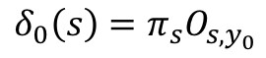
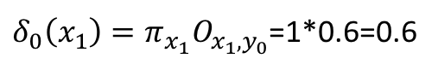
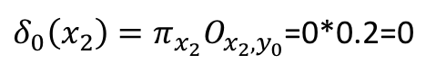
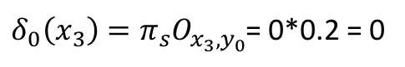
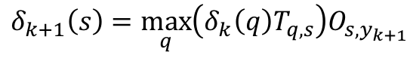
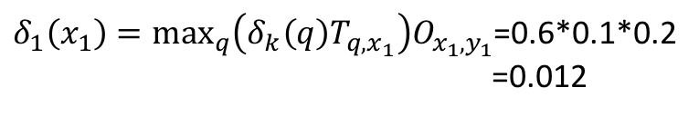
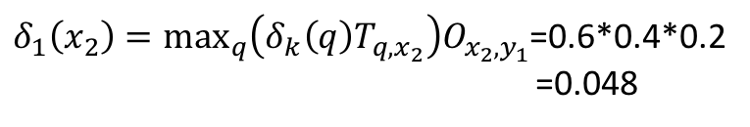
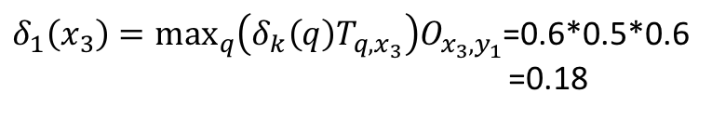
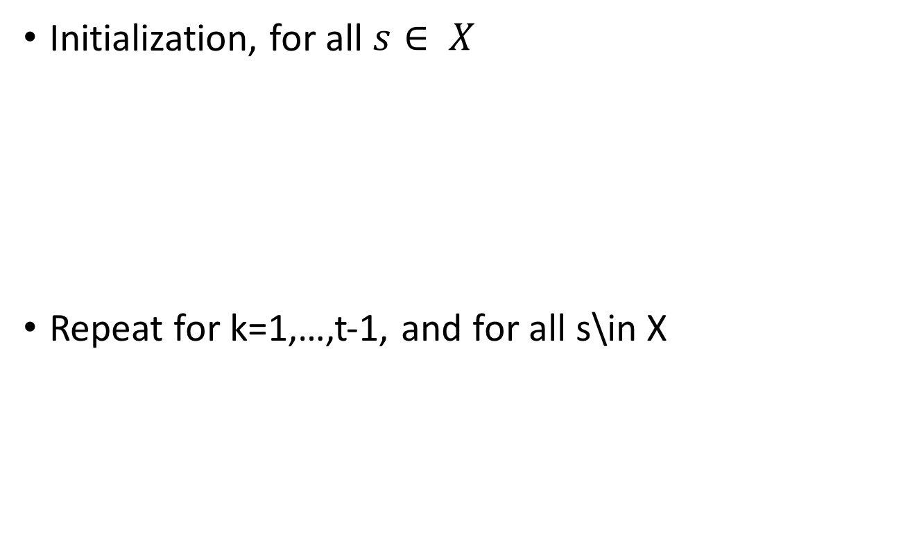
Viterbi Algorithm: Model A Mole Example
Initialization, for all $s∈ X$
Repeat for k=1,…,t-1, and for all s\in X
Y=(1,3,3)
x₁
x₁
x₁
x₁
$$δ_{0}\left(s\right)=π_{s}O_{s,y_{0}}$$
x₂
x₂
x₂
x₂
$δ_{0}\left(x_{1}\right)=π_{x_{1}}O_{x_{1},y_{0}}$=1*0.6=0.6
$δ_{0}\left(x_{2}\right)=π_{x_{2}}O_{x_{2},y_{0}}$=0*0.2=0
x₃
x₃
x₃
x₃
$δ_{0}\left(x_{3}\right)=π_{s}O_{x_{3},y_{0}}$= 0*0.2 = 0
t=0
t=1
t=2
Y=(1,3,3)
x₁
x₁
x₁
x₁
$$δ_{k+1}\left(s\right)=\max_{q}\left(δ_{k}\left(q\right)T_{q,s}\right)O_{s,y_{k+1}}$$
x₂
x₂
x₂
x₂
$δ_{1}\left(x_{1}\right)=\max_{q}\left(δ_{k}\left(q\right)T_{q,x_{1}}\right)O_{x_{1},y_{1}}$=0.6*0.1*0.2
=0.012
x₃
x₃
x₃
x₃
$δ_{1}\left(x_{2}\right)=\max_{q}\left(δ_{k}\left(q\right)T_{q,x_{2}}\right)O_{x_{2},y_{1}}$=0.6*0.4*0.2
=0.048
t=0
t=1
t=2
$δ_{1}\left(x_{3}\right)=\max_{q}\left(δ_{k}\left(q\right)T_{q,x_{3}}\right)O_{x_{3},y_{1}}$=0.6*0.5*0.6
=0.18

Slide 23
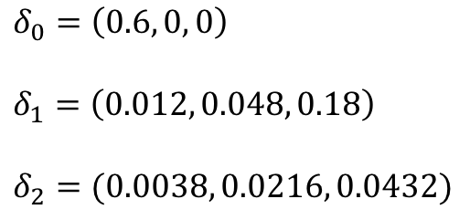
Viterbi Algorithm: Model A Mole Example
Continue to the end and get
End state of most likely path: 3
Most likely path: 1→3→3
Joint probability of path + observations=0.0432
$$δ_{0}=\left(0.6, 0, 0\right)$$
$$δ_{1}=\left(0.012, 0.048, 0.18\right)$$
$$δ_{2}=(0.0038, 0.0216, 0.0432)$$

Slide 24
Next Time
POMDP
Introduction to SLAM
Reminder: HW 4 is due next week, final project presentations begin week after next (~2 weeks)!
Final project presentation schedule posted later today

Slide 25
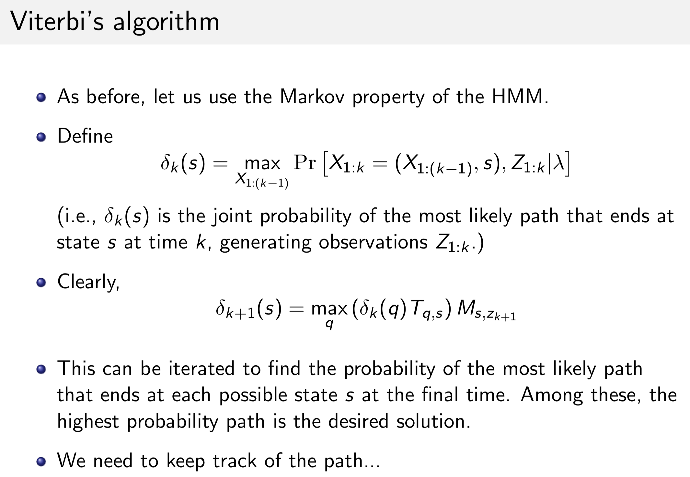
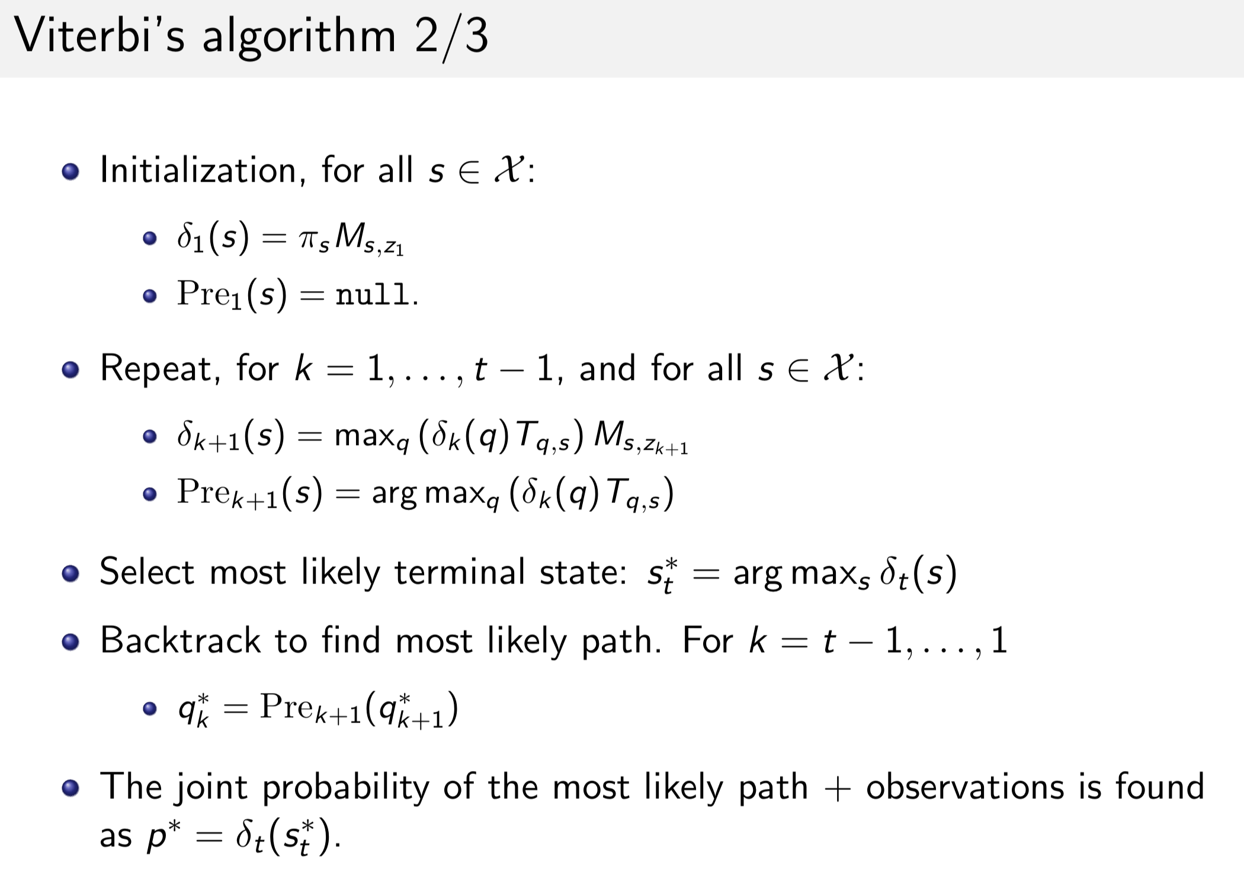
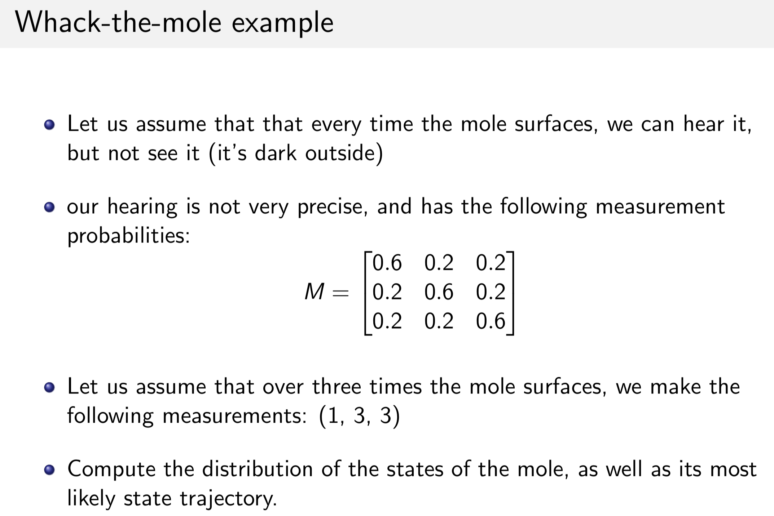

Slide 26
